Slide 1


Progress Review 2 Event-Mate: A sustainable & Inclusive Event Mannagement
Department of Computer Science & Engineering
CHITKARA UNIVERSITY , HIMACHAL PRADESH
Submitted To :
Mr. Rinku Saini Sir
Assistant Professor
Submitted By:
Dhruv Kumar Sharma 2411981191
Deshna Jain 2411981182
Divyanshi Thakur 2411981200
Dilpreet 2411981196
Date – 23 April , 2025 1

Slide 2
CONTENTS
SDG Goals Mapping
Problem Statement
Introduction of the project
Projective Objective
AI Chat Bot & Virtual Assistant
BMI Calculator
Personalized Calorie Calculator
Fit Hub E-Learn
Fit Hub Store
Nutrition Plans
Methodology
Requirement Gathering & Data Collection
Design Phase: ERD
Data Flow Diagram
Multidisciplinary Approach
Novelty Factor
Challenges Faced !
Login-Page
Main Page
BMI Calculator
Workouts
Virtual Assistant
Chat Bot
E-Learning –Workout
E-Learning –Yoga
Muscle Gain Pro
Muscle Gain Calorie Calculator
Supplements Store
Protein Powders
Creatine Supplements
Vitamins & Minerals Supplements
Fat Burners & Appetite Suppressants
Bookstore
Protein Guides
Creatine Guides
Pre-Workout Guides
Sustainable Goals Covered
Developers
Join Now Page
Date – 23 April , 2025 2

Slide 3
SDG Goals
8. Decent Work and Economic Growth
9. Industry innovation and Infrastructure.
17.Partnerships for the Goals .
Date – 23 April , 2025 3

Slide 4
PROBLEM STATEMENT
Traditional event management processes often lead to high costs, environmental waste, and limited inclusivity. Many event platforms focus solely on logistics and ticketing without considering the sustainability and social impact of events. Issues such as carbon footprint from travel, excessive resource consumption, lack of accessibility for marginalized.
There is a need for an eco-friendly, socially responsible, and technologically advanced event management platform that promotes sustainable event planning, digital solutions to reduce waste, and inclusivity while ensuring economic opportunities for all stakeholders.
Date – 23 April , 2025 4

Slide 5
🎯 INTRODUCTION OF THE PROJECT
✅ Events Plans
📍 Build your Event’s reputation with pocket friendly management
✅ Tech & Integration 🔗📱
📍 Mobile-friendly design, and future mobile app development.
Included Features
✅ Event-Mate Manager
📍 An Event Manager to manage events.
✅ Interactive Tools & AI Assistance 🤖📊
📍 AI chatbot
Date – 23 April , 2025 5

Slide 6
✨ Project Objective
Promote Sustainable Event Practices.
Enhance Accessibility and Inclusivity
Support Local Economies & Businesses
Leverage Technology for Smart Event Management
Encourage Responsible Consumption and Production
Build a Community-Driven Approach.
Date – 23 April , 2025 6

Slide 7
🤖AI Chat Bot & Virtual Assistant
💬 Personalized Workout Navigation:
Instantly guides users to targeted SVG-based workout sections.
Learns from interactions to improve future recommendations
🏃 Smooth Access to Visual Workouts:
Directs users to visually rich SVG illustrations of each exercise
Covers all muscle groups – chest, back, legs, arms & shoulders .
Easy-to-follow animations for proper form and movement
🕒 Available 24/7 – Anytime, Anywhere:
Always ready to assist, day or night
Friendly, human-like responses to keep users engaged
Ensures round-the-clock support for your fitness journey💪💙
🌐 Seamlessly Integrated UI:
Always accessible via floating chatbot icon
Supports Voice & text input for flexible interaction
🚀 Enhanced User Journey:
Makes the platform feel more interactive & guided
Reduces confusion and boosts workout confidence
Turns visitors into long-term, engaged users.
Date – 23 April , 2025 7

Slide 8
⚖️BMI CALCULAT0R Know Your Body Better
📏 Simple Input System:
Users enter their height (in cm/feet) and weight (in kg/lbs)
Clean and user-friendly input interface
📊 Instant BMI Result:
Calculates BMI instantly using standard formula
Displays numerical value of BMI along with interpretation
🧍‍♂️ Health Category Breakdown:
Categorizes user as:
Underweight
Normal weight
Overweight
Obese
🔁 Quick Reset & Recalculate Option:
Users can easily adjust inputs and recalculate
Mobile-optimized for fast use on-the-go
Date – 21 April , 2025 Fit Hub : Your Path To Health , Wellness & EducationThrough Innovation 7

Slide 9
Personalized Calorie Calculator🔥 Tailored Fuel for Your Goals
🧍‍♂️ Fully Personalized Input:
Takes key personal info: Gender, Age, Height, Weight
Let users select Fitness Goals – Lose Fat, Maintain, or Build Muscle
🥗 Macronutrient Breakdown:
Provides a daily split of:
Protein (g) – for muscle repair & growth
Carbohydrates (g) – for energy
Fats (g) – for hormones & overall health
Split is goal-specific (e.g. higher protein for fat loss/muscle gain)
🔄 Quick Edit & Recalculate:
Instantly modify inputs and see how changes affect results
Optimized for both desktop & mobile use.
Date – 21 April , 2025 Fit Hub : Your Path To Health , Wellness & EducationThrough Innovation 8

Slide 10
Fit Hub E-Learn🎥 Your Fitness Video Hub
💪 Workout Categories Covered:
Chest | Back | Legs | Biceps & Triceps | Shoulders
Ideal for all fitness levels – beginner to advanced
🧘 Yoga Styles for Mind-Body Balance:
Iyengar | Ashtanga | Vinyasa | Kundalini | Yin | Restorative.
Each style explained with detailed video sessions.
Focus on flexibility, relaxation, and inner strength.
🌟 Real Stories, Real Results:
Inspiring transformation journeys
Builds community trust and engagement.
🔄 Interactive , Consistent User Experience & Animated UI:
Smooth hover effects on all video tiles
Fully responsive and mobile-friendly
Seamless navigation between workouts, yoga, and testimonials.
Date – 21 April , 2025 Fit Hub : Your Path To Health , Wellness & Education Through Innovation 9

Slide 11
🛒Fit Hub Store Fuel Your Fitness Journey
🥤 Top-Quality Gym Supplements:
Protein Powders – Whey, Casein, Plant-based & Isolate options
Pre-Workout Boosters – Enhanced energy, focus & endurance
Creatine Supplements – Strength & performance enhancers
Vitamins & Minerals – Complete daily wellness support
Fat Burners & Appetite Suppressants – Smart weight management
📚 Expert-Curated Guide Books:
Protein Guide – Understand types, timing & dosage
Pre-Workout Guide – Maximize energy & efficiency
Creatine Guide – Myths, benefits & usage breakdown
Vitamins & Minerals Guide – Essential nutrients for peak health
💡 Smart Shopping Experience & Seamless Navigation🧭 :
Clean, intuitive layout with hover-based product previews
Smooth scroll-to-section transitions on selection
Fully responsive design for desktop & mobile users
Date – 21 April , 2025 Fit Hub : Your Path To Health , Wellness & Education Through Innovation 10

Slide 12
🥦Nutrition Plans Eat Smart ,Fuel Right
🏋️ Muscle Gain Plans:
High-protein, calorie-surplus diets designed for lean muscle growth
Includes meal timing, portion sizes, and pre/post-workout nutrition
Flexible options: non-veg, veg & dairy-inclusive plans
🔥 Fat Loss Plans:
Calorie-deficit meal plans to support healthy weight reduction
Focused on satiety, metabolism-boosting foods & clean eating
Comes with snack swaps, low-carb/high-fiber meal guides
🌱 Plant-Based Daily Calorie Plans:
100% vegetarian and vegan-friendly options
Structured for both muscle gain & fat loss goals
Covers daily protein requirements with plant-based sources
🍽️ Easy-to-Follow Meal Breakdowns:
Split by breakfast, lunch, dinner & snacks
Includes macronutrient values & portion recommendations
Date – 21 April , 2025 Fit Hub : Your Path To Health , Wellness & Education Through Innovation 11

Slide 13

Methodology
🚀 Start – Kick off the website development journey!
📌 Define Requirements – Identify the website’s purpose & must-have features 🏋️‍♂️🍎💬📊📱
📁 Set Up Project Folder – Organize files: 🏗️ index.html 🎨 styles.css ⚙️ script.js
🖥️ Design Structure (HTML) – Build the layout, sections & content placeholders 🏠
🎨 Style Website (CSS) – Add colors, fonts & responsive design ✨💡
⚡ Add Interactivity (JavaScript) – Make the site dynamic & interactive 🎮🖱️
🚀 Optimize Performance – Improve speed, responsiveness & asset loading ⏳⚙️
🛠️ Test Website – Check compatibility, fix bugs & gather feedback ✅🔎
🔄 Maintenance & Updates – Keep improving content & features 🔧📈
🏁 End – Project complete! Time to launch 🎉🎯
Date – 21 April , 2025 Fit Hub : Your Path To Health , Wellness & EducationThrough Innovation 23

Slide 14

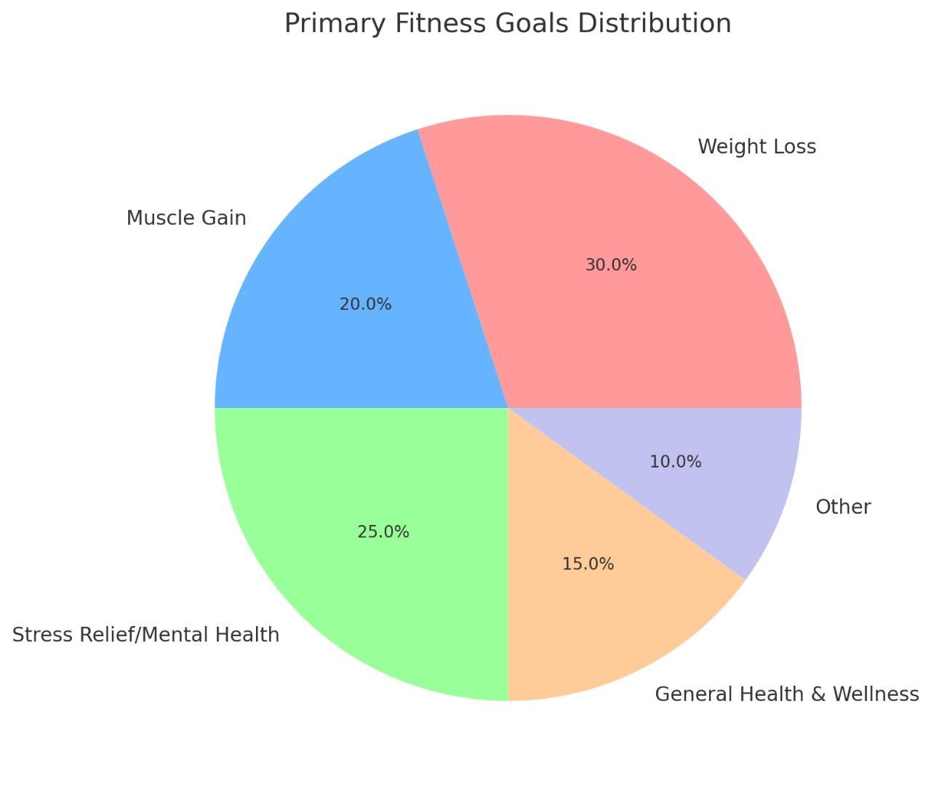
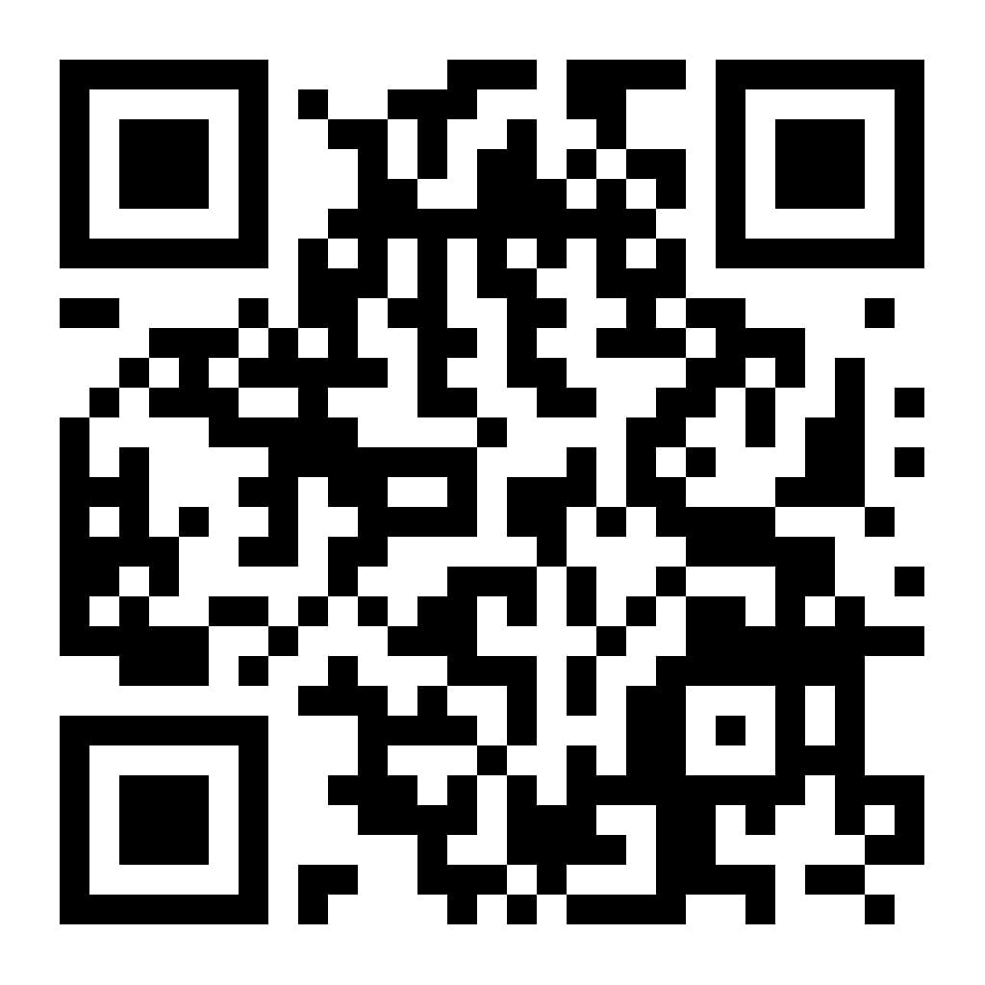
Requirement Gathering & Data Collection
📊 Why Create a Fitness Website ?
Our pie chart analysis created from results of survey done through GOOGLE FORM
shows diverse fitness needs—weight loss, muscle gain, stress relief, and general wellness.
Many people struggle with lack of time, motivation, and proper guidance.
To solve these challenges, we decided to build a fitness website that offers:
✅ Gym Workouts , meal plans & more
✅ Fit hub Store & Fit hub E-Learning Platform.
✅ AI Chat bot , virtual assistant for better user experience
💡 Conclusion: The website will make fitness accessible, structured, engaging helping users stay on track with their goals! 🚀💪
Date – 21 April , 2025 Fit Hub : Your Path To Health , Wellness & Education Through Innovation 14

Slide 15
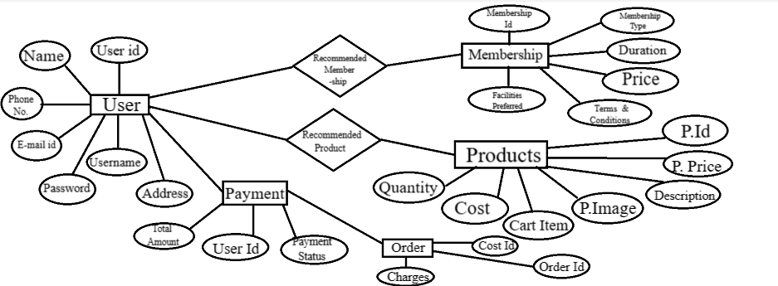
Design Phase : Entity Relationship Diagram
Date – 21 April , 2025 Fit Hub : Your Path To Health , Wellness & Education Through Innovation 15

Slide 16
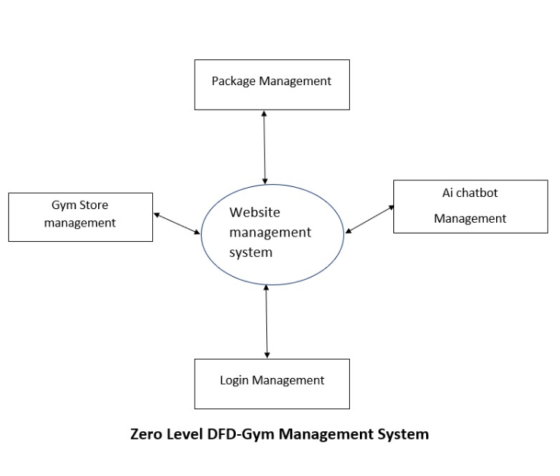
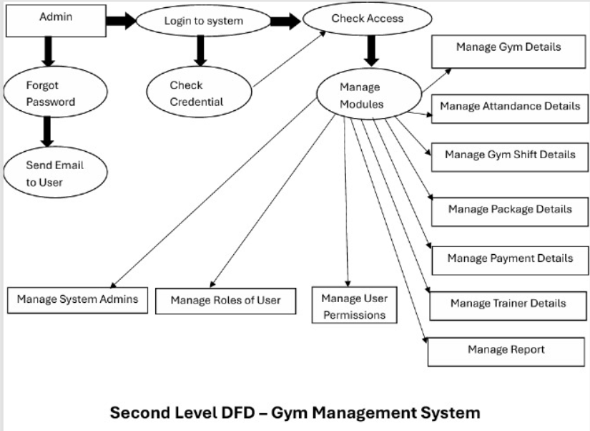
Data Flow Diagram
Date – 21 April , 2025 Fit Hub : Your Path To Health , Wellness & Education Through Innovation 16

Slide 17
🔗 Multidisciplinary Approach
💪 Fitness & Exercise Science Structured workout plans and SVG demonstrations based on principles of physical training and kinesiology.
🍽️ Nutrition & Dietetics Personalized diet plans and calorie calculators crafted using nutritional science to support varied health goals.
🧘 Mental Health & Wellness Includes mindfulness tips, yoga sessions, and mental health resources for a balanced mind-body connection.
🧠 Technology & AI Integration Features AI-powered chatbots, virtual assistants, and interactive tools for a smarter, user-centric fitness experience.
📘 Education & E-Learning Offers educational content through an integrated platform, promoting continuous learning in fitness, wellness, and sustainability.
Date – 21 April , 2025 Fit Hub : Your Path To Health , Wellness & Education Through Innovation 17

Slide 18
✨ Novelty Factor
⚖️ Comparison with Others:
❌ Standard gym websites = Just basic info & workout plans
✅ Our Website = Next-level experience
🧠 Smart Tools Beyond Basics Unlike standard sites, Fithub includes BMI & Calorie Calculators, an AI chatbot, and a Virtual Assistant for real-time support and guidance.
🛒 Built-in Fitness Store & Bookstore Integrated e-commerce platforms offering fitness gear, healthy supplements, and educational books—all in one place.
📚 E-Learning Platform for Holistic Growth Combines workouts with an educational hub offering fitness certifications, mental health modules, and nutrition courses.
🎨 Interactive SVG Workouts & Animated UI Features SVG-based workout illustrations and high-end animations, making learning and tracking exercises visually engaging.
Date – 21 April , 2025 Fit Hub : Your Path To Health , Wellness & Education Through Innovation 18

Slide 19
⚠️ Challenges Faced!
🔧 Complex Feature Integration Seamlessly combining diverse modules like meal plans, workout routines, AI chatbot, virtual assistant, and store was technically demanding.
⚙️ Performance vs Animation Balance Incorporating engaging animations without affecting website speed and responsiveness required careful optimization.
💻📱 Responsive & Cross-Platform Design Ensuring a consistent and smooth experience across desktops, tablets, and mobile devices posed design and testing challenges.
🔗 API Integration Difficulties Integrating third-party APIs for AI responses led to data inconsistency and occasional delays.
🔒 Data Security & Personalization Handling user-specific fitness and health data securely while delivering personalized experiences required robust backend logic and encryption.
Date – 21 April , 2025 Fit Hub : Your Path To Health , Wellness & Education Through Innovation 19

Slide 20
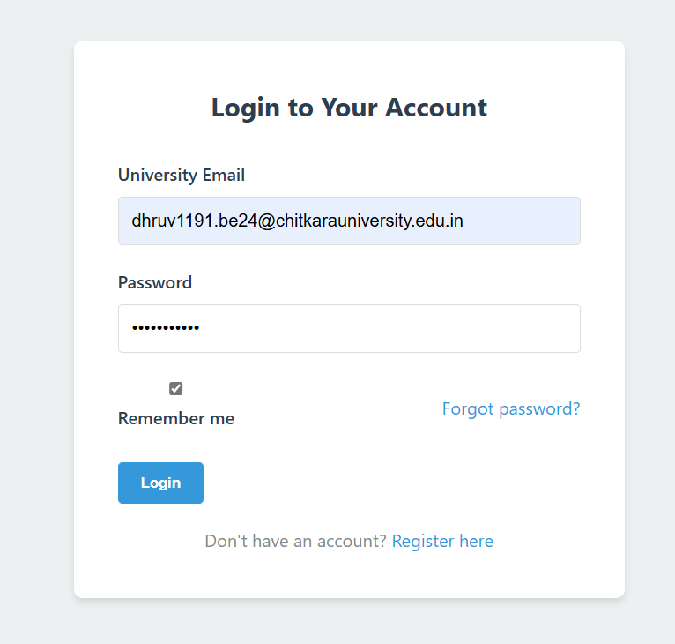
Login-Page
Login of the Fithub website displaying user interaction
Date – 23 April , 2025 20

Slide 21
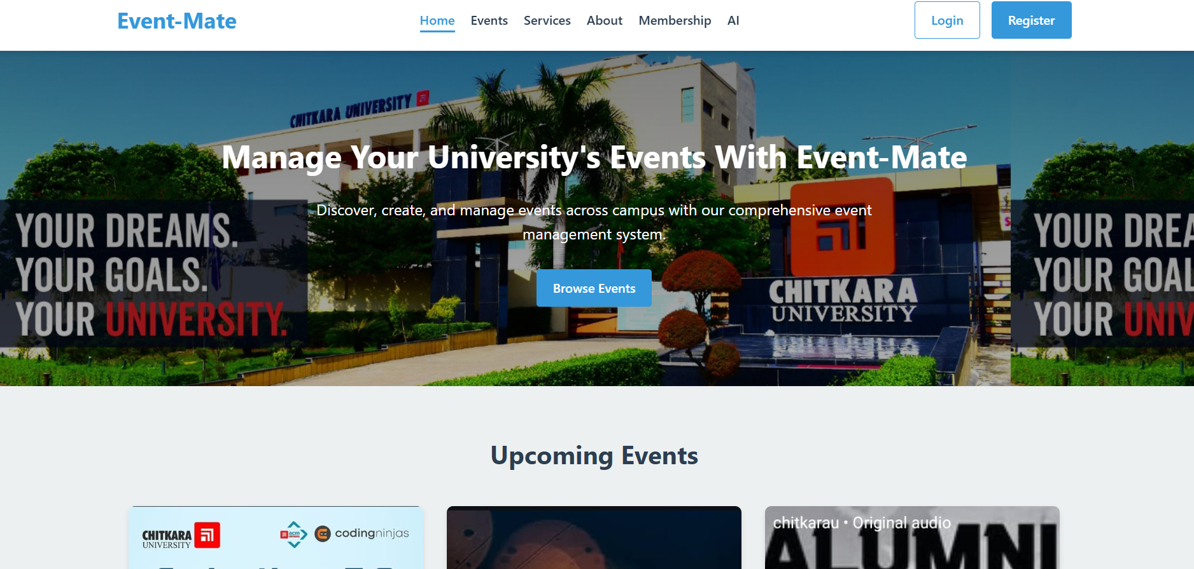
Main Page
Date – 23 April , 2025 21

Slide 22
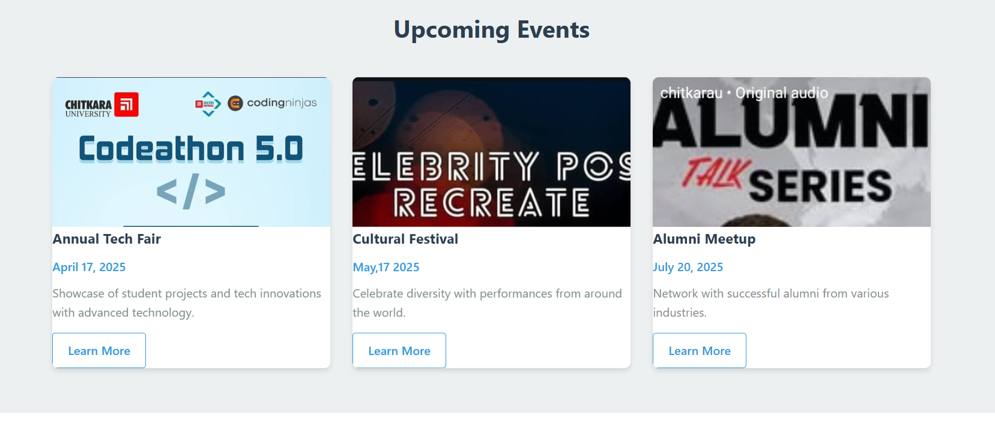
Upcoming Events
Date – 23 April , 2025 22

Slide 23
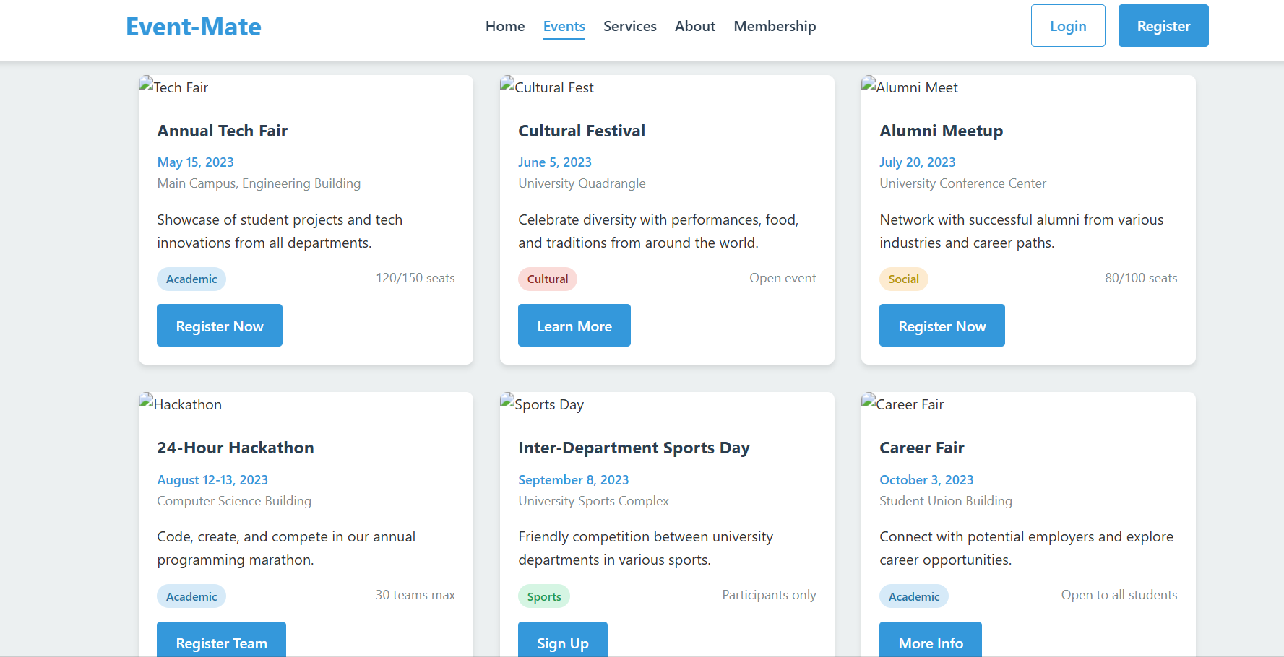
Events Details
Date – 23 April , 2025 23

Slide 24
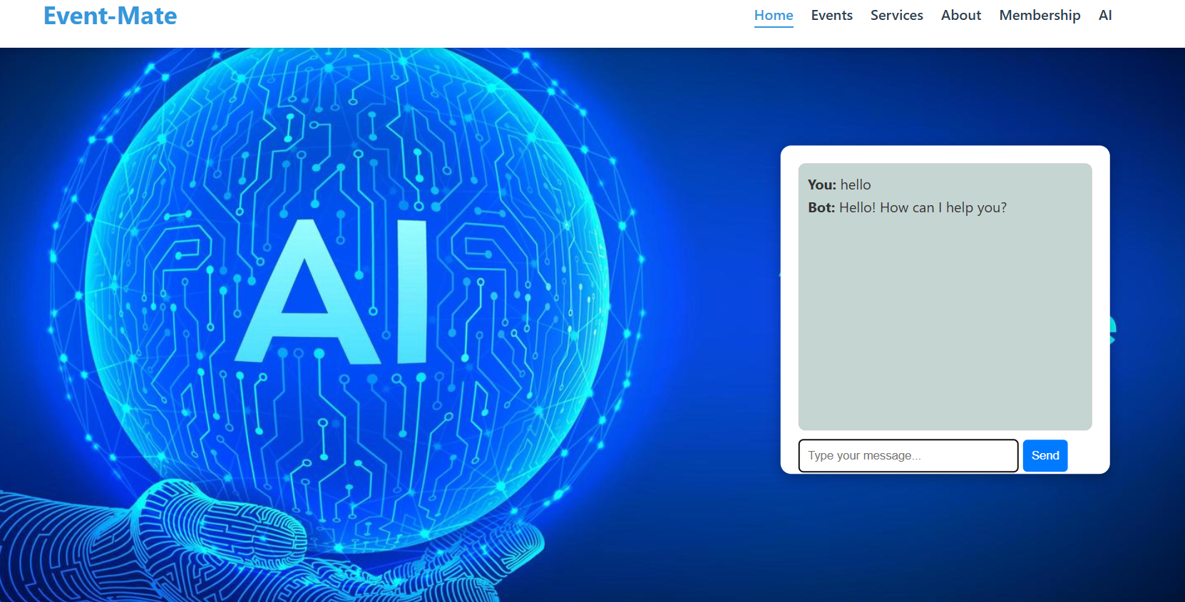
CHAT BOT
Ask by text—our chatbot answers all your workout-related queries instantly!
Date – 23 April , 2025 24

Slide 25
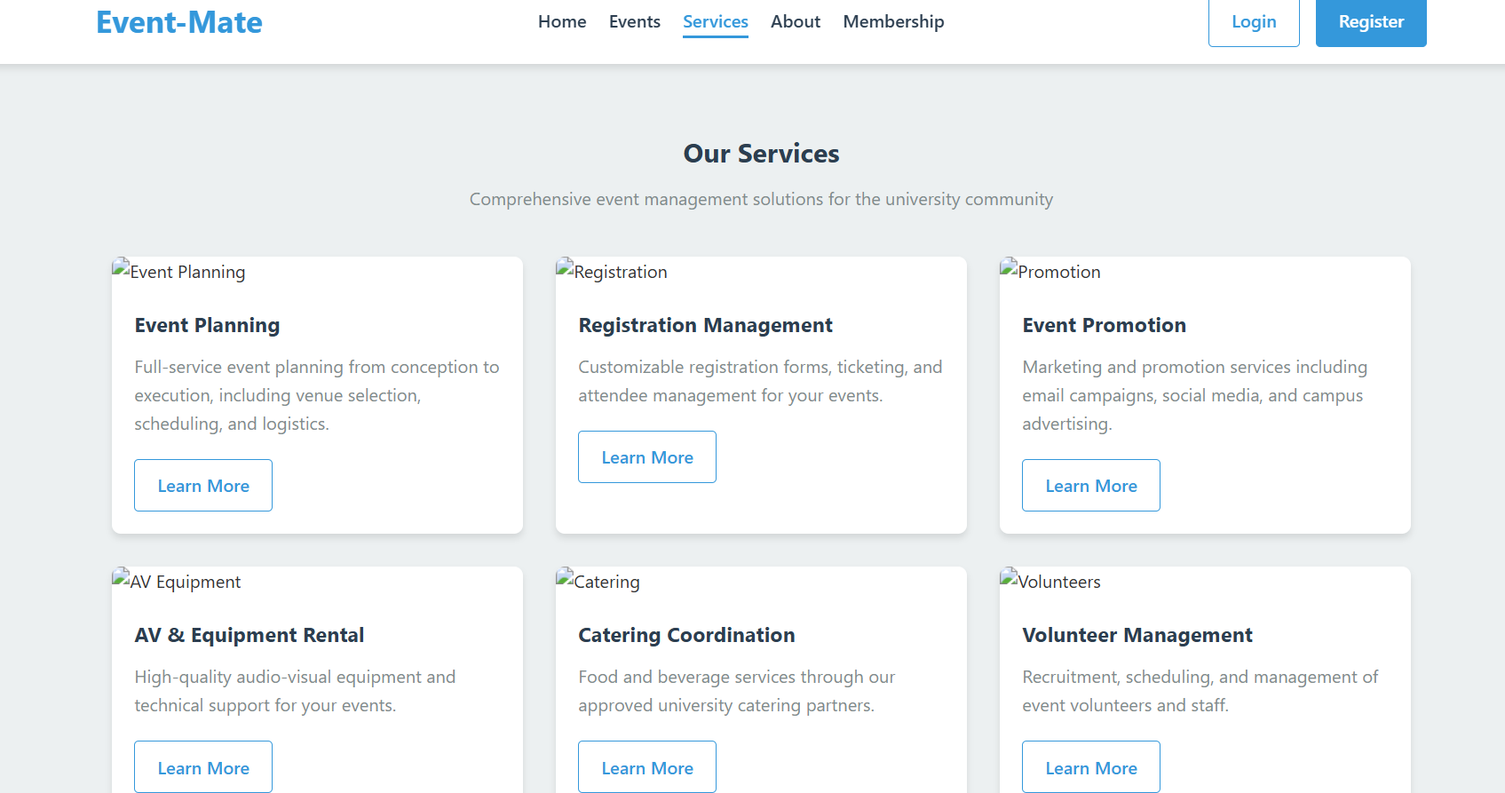
Services
Date – 23 April , 2025 26

Slide 26
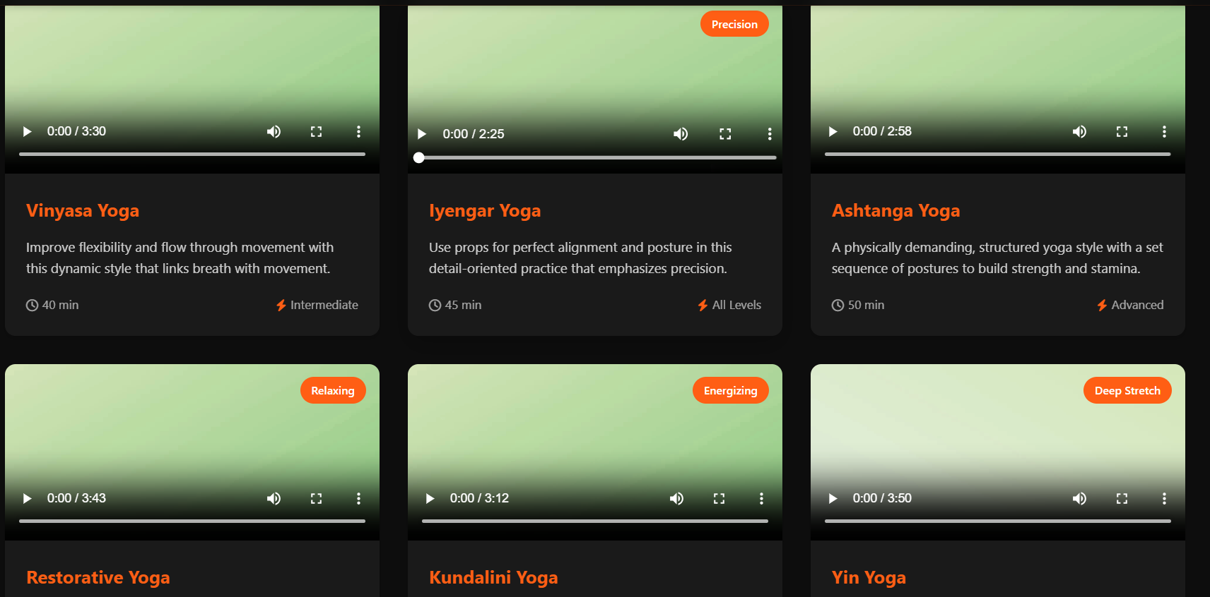
E-LEARNING
E-learning section showing Yoga tutorials of Fit Hub
Date – 21 April , 2025 Fit Hub : Your Path To Health , Wellness & Education Through Innovation 27

Slide 27
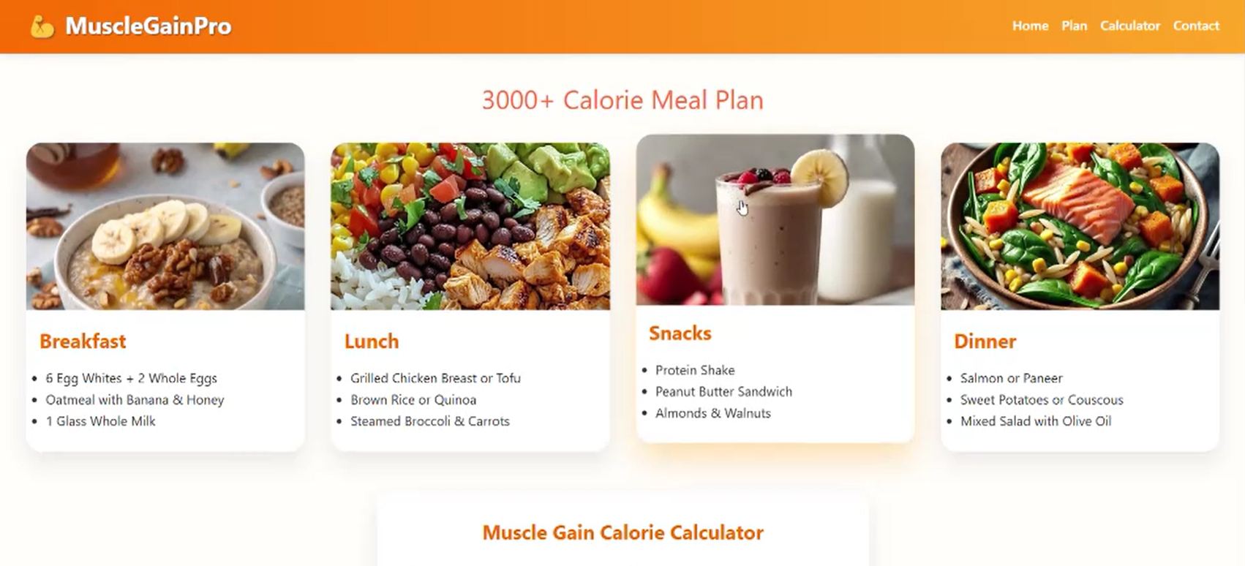
MUSCLE GAIN PRO
This slide shows essential tips and strategies to boost muscle growth of Muscle Gain Pro Section
Date – 21 April , 2025 Fit Hub : Your Path To Health , Wellness & Education Through Innovation 28

Slide 28
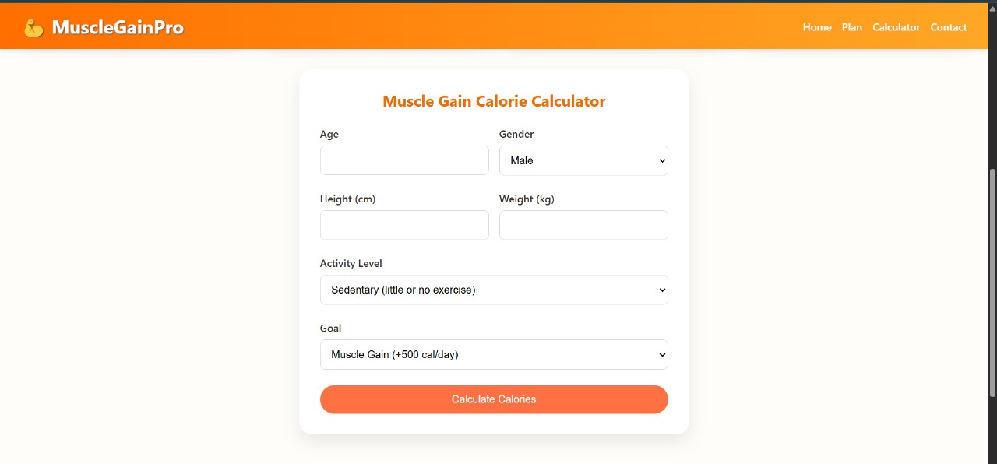
MUSCLE GAIN CALORIE CALCULATOR
Image showing the Muscle Gain Calorie Calculator Of Muscle Gain Pro Section
Date – 21 April , 2025 Fit Hub : Your Path To Health , Wellness & Education Through Innovation 29

Slide 29
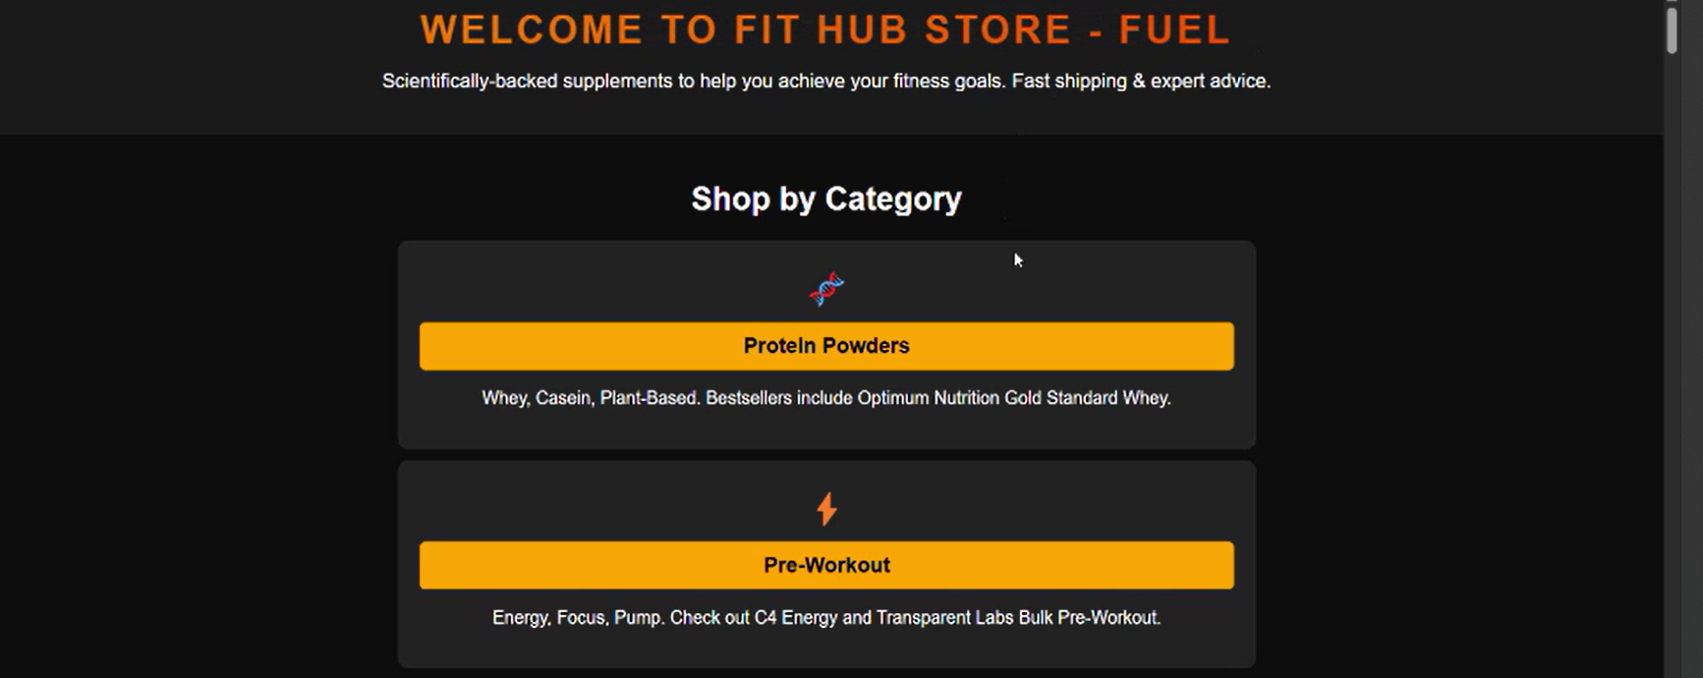
SUPPLEMENTS STORE
Image showing interface of Supplements store
Date – 21 April , 2025 Fit Hub : Your Path To Health , Wellness & Education Through Innovation 30

Slide 30
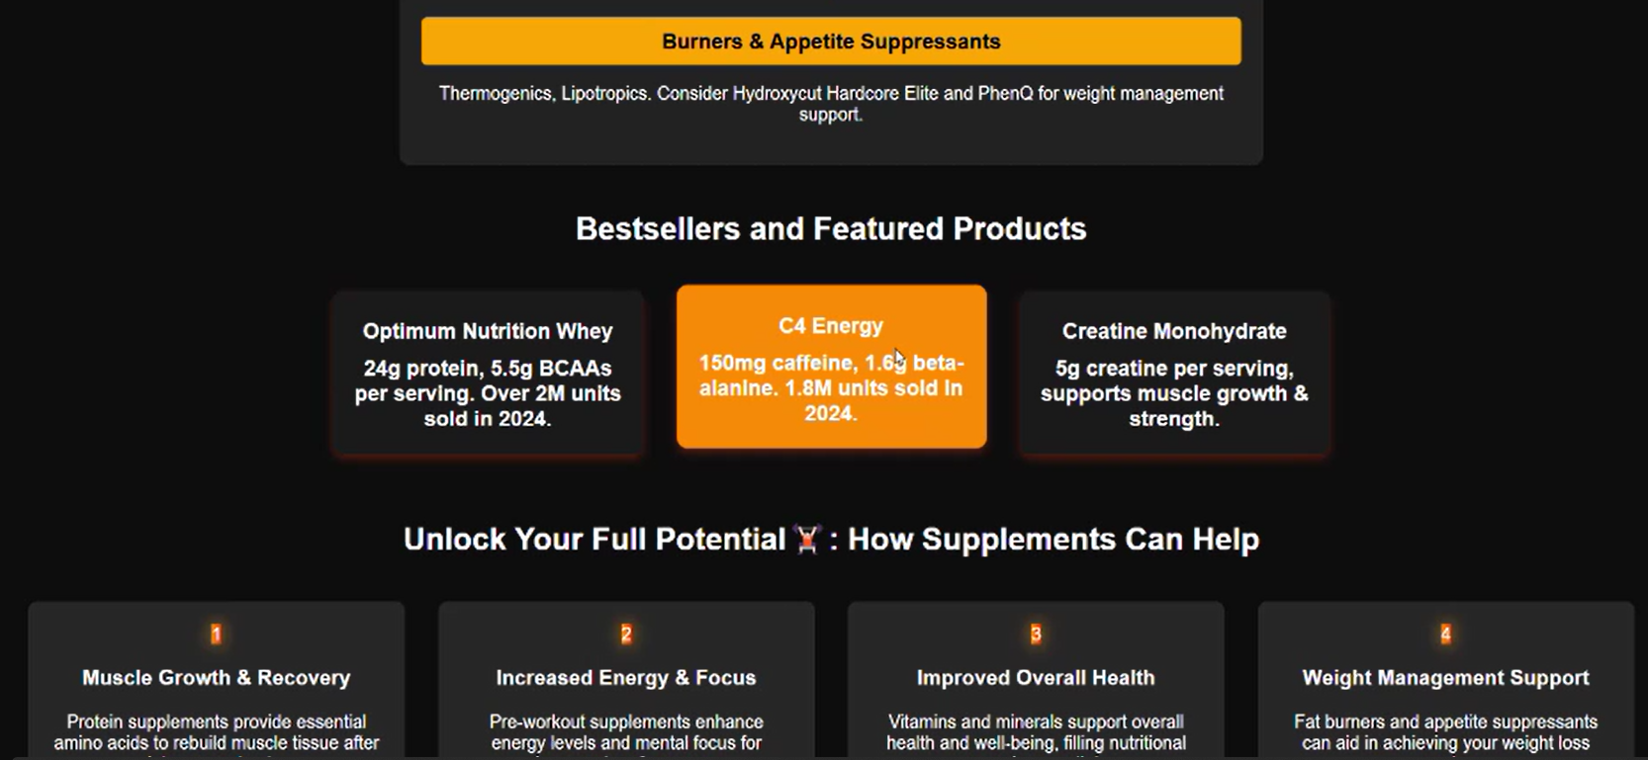
SUPPLEMENTS STORE
Image showing Bestsellers and Featured Products Of Store
Date – 21 April , 2025 Fit Hub : Your Path To Health , Wellness & Education Through Innovation 31

Slide 31
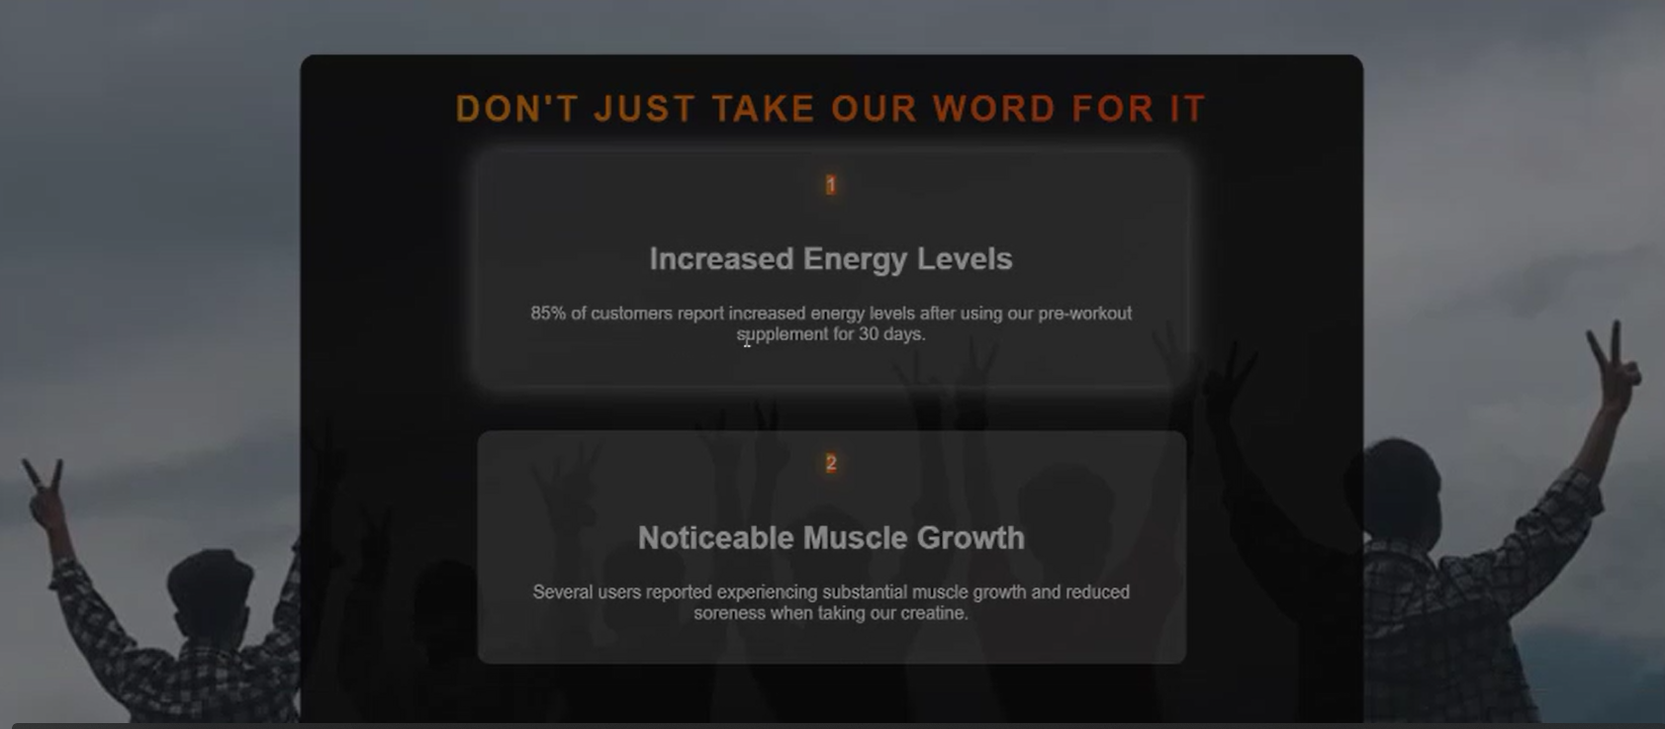
SUPPLEMENTS STORE
Date – 21 April , 2025 Fit Hub : Your Path To Health , Wellness & Education Through Innovation 32

Slide 32
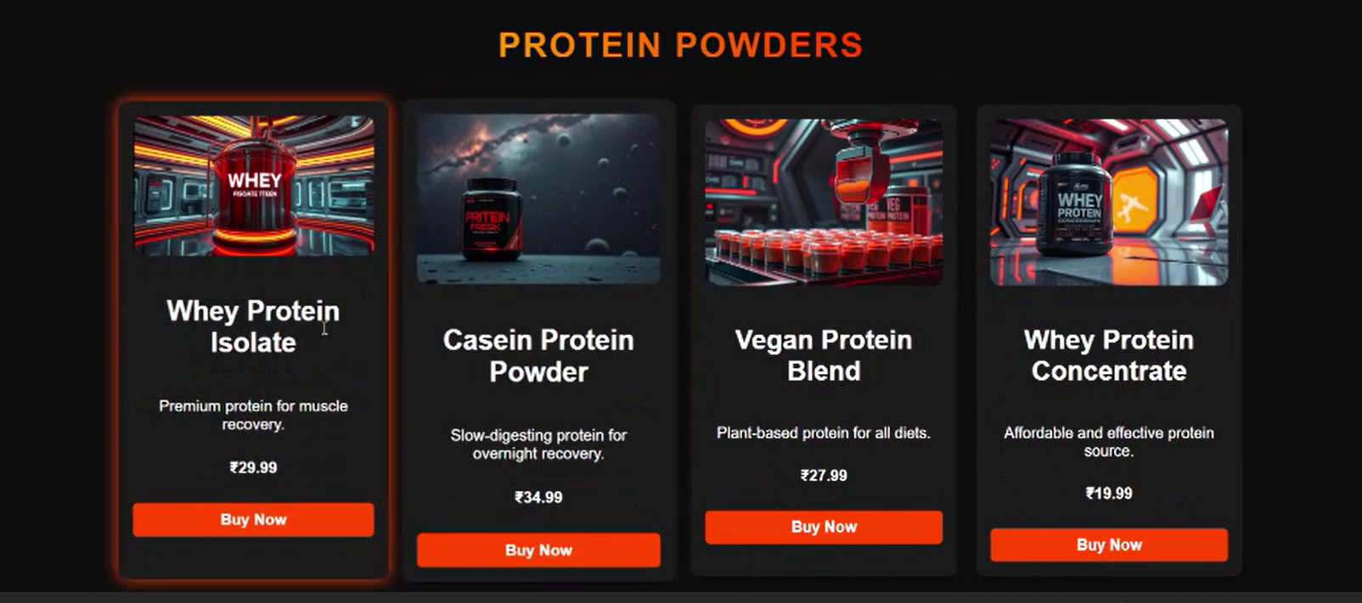
PROTEIN POWDERS
Image showing Protein Powder Products Of Fit Hub Store
Date – 21 April , 2025 Fit Hub : Your Path To Health , Wellness & Education Through Innovation 33

Slide 33
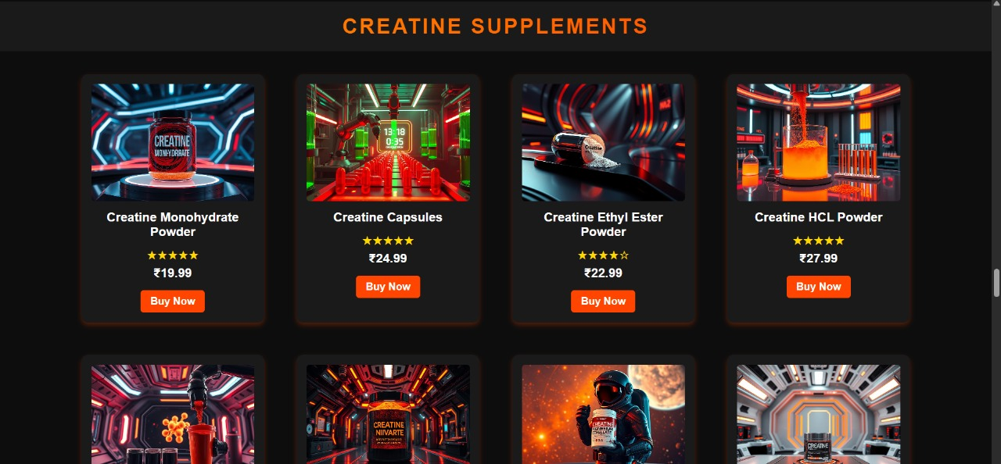
CREATINE SUPPLEMENTS
Image showing Creatine Products Of Fit Hub Store
Date – 21 April , 2025 Fit Hub : Your Path To Health , Wellness & Education Through Innovation 34

Slide 34
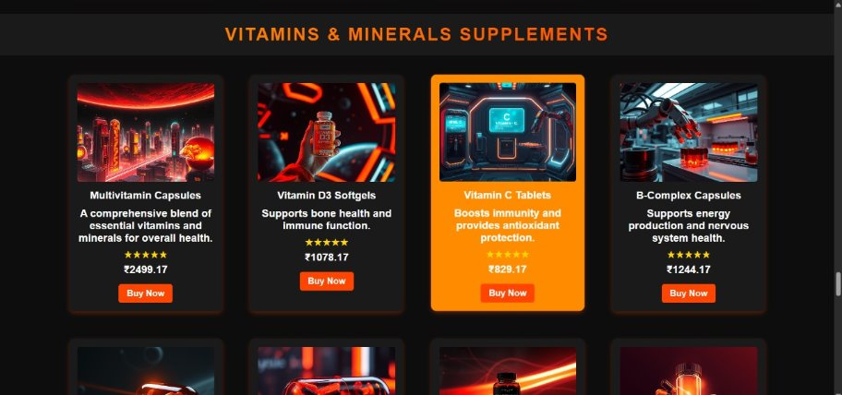
VITAMINS & MINERALS SUPPLEMENTS
Image showing Vitamins & Minerals Products Of Fit Hub Store
Date – 21 April , 2025 Fit Hub : Your Path To Health , Wellness & Education Through Innovation 35

Slide 35
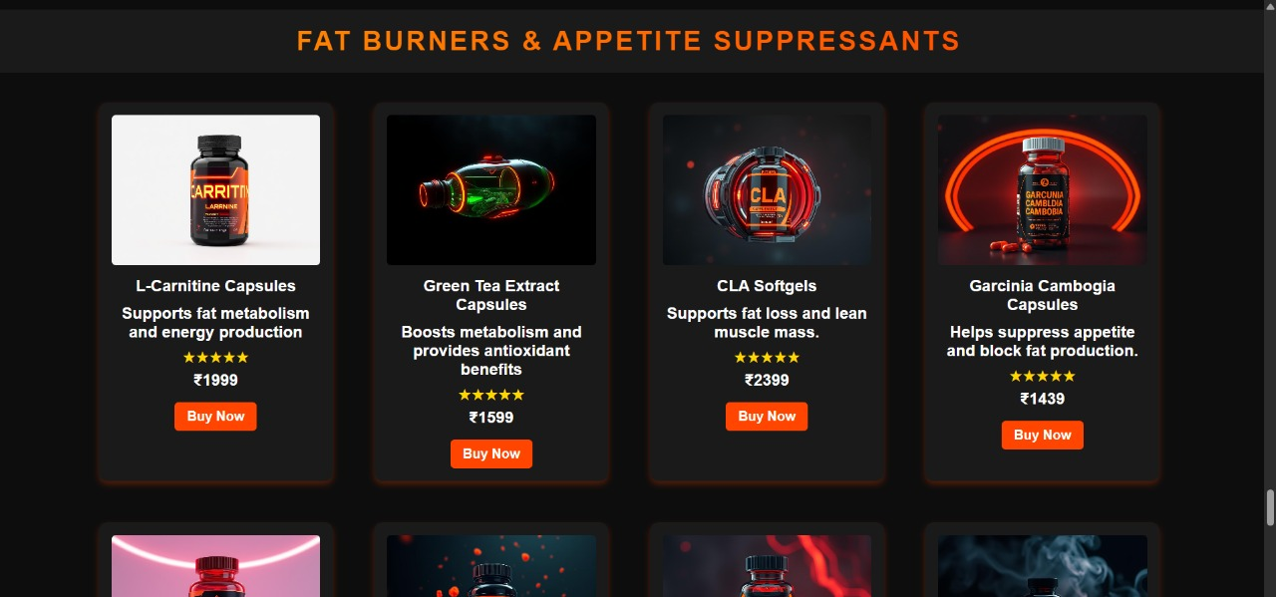
FAT BURNERS & APPETITE SUPPRESSANTS
Image showing Fat Burner & Appetite Products Of Fit Hub Store
Date – 21 April , 2025 Fit Hub : Your Path To Health , Wellness & Education Through Innovation 36

Slide 36
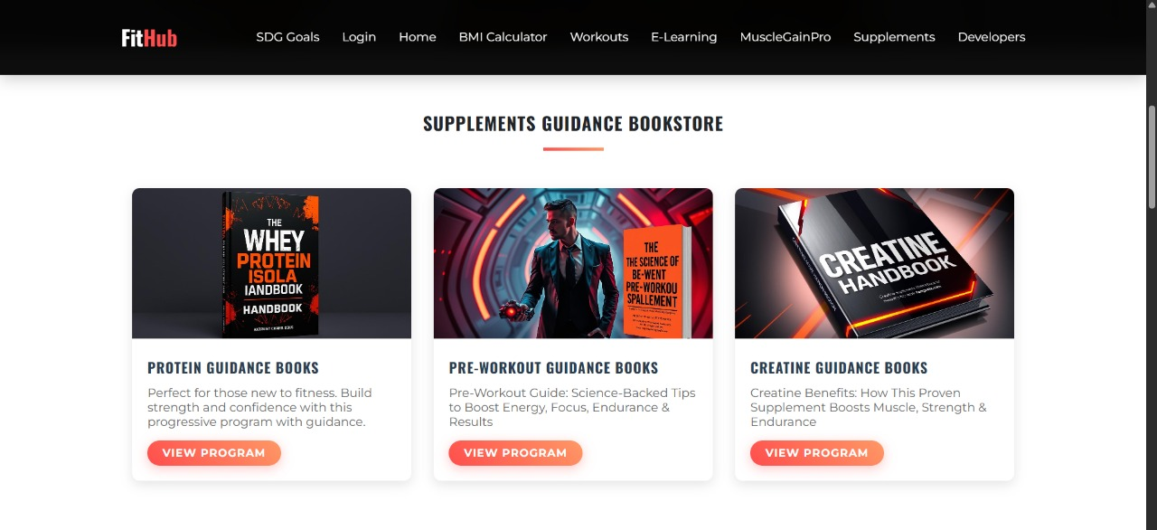
BOOKSTORE
Image showing Bookstore of Fit Hub
Date – 21 April , 2025 Fit Hub : Your Path To Health , Wellness & Education Through Innovation 37

Slide 37
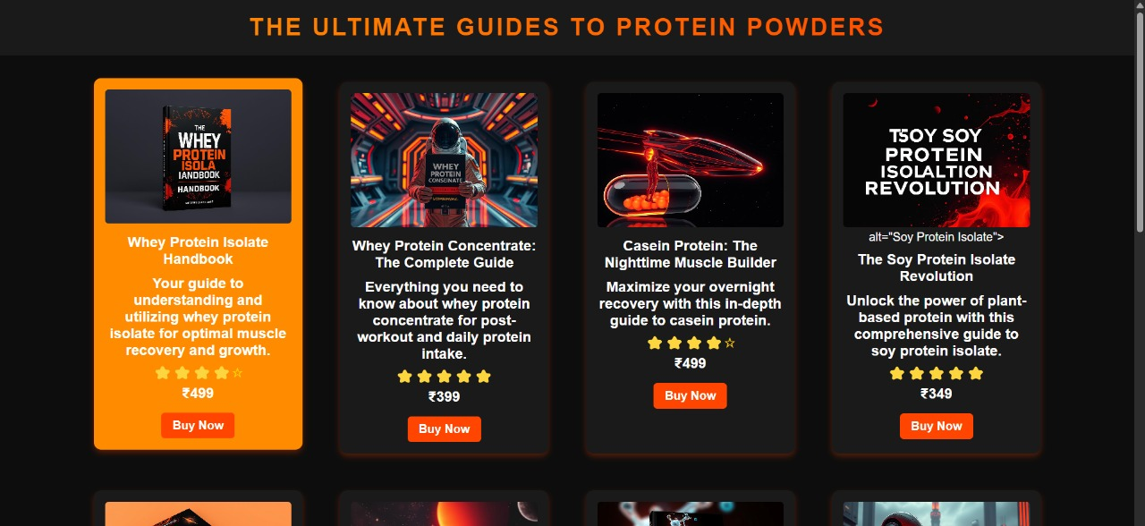
PROTEIN GUIDES
Image showing Protein guides of Fit Hub Books store
Date – 21 April , 2025 Fit Hub : Your Path To Health , Wellness & Education Through Innovation 38

Slide 38
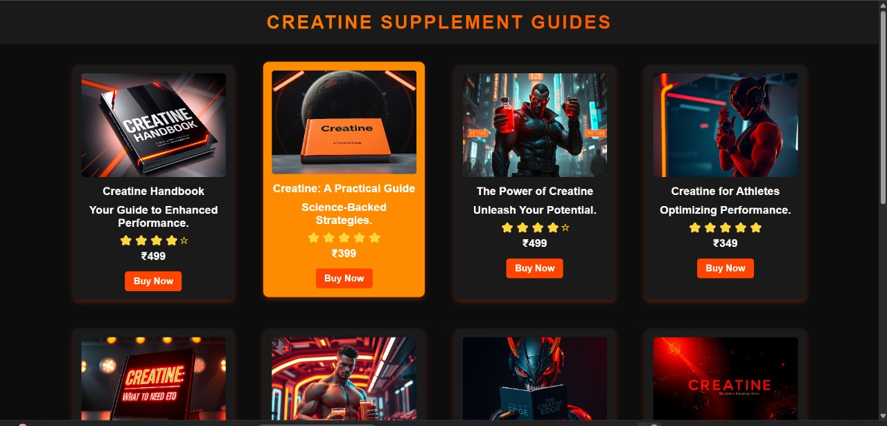
CREATINE SUPPLEMENT GUIDES
Date – 21 April , 2025 Fit Hub : Your Path To Health , Wellness & Education Through Innovation 32
Image showing Creatine guides of Fit Hub Books store
Date – 21 April , 2025 Fit Hub : Your Path To Health , Wellness & Education Through Innovation 39

Slide 39
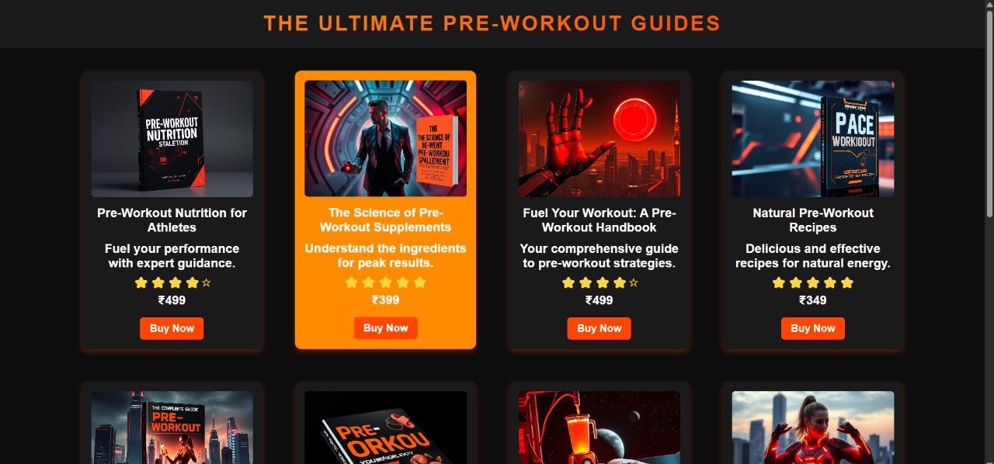
PRE-WOROUT GUIDES
Image showing Pre-Workout guides of Fit Hub Books store
Date – 21 April , 2025 Fit Hub : Your Path To Health , Wellness & Education Through Innovation 40

Slide 40
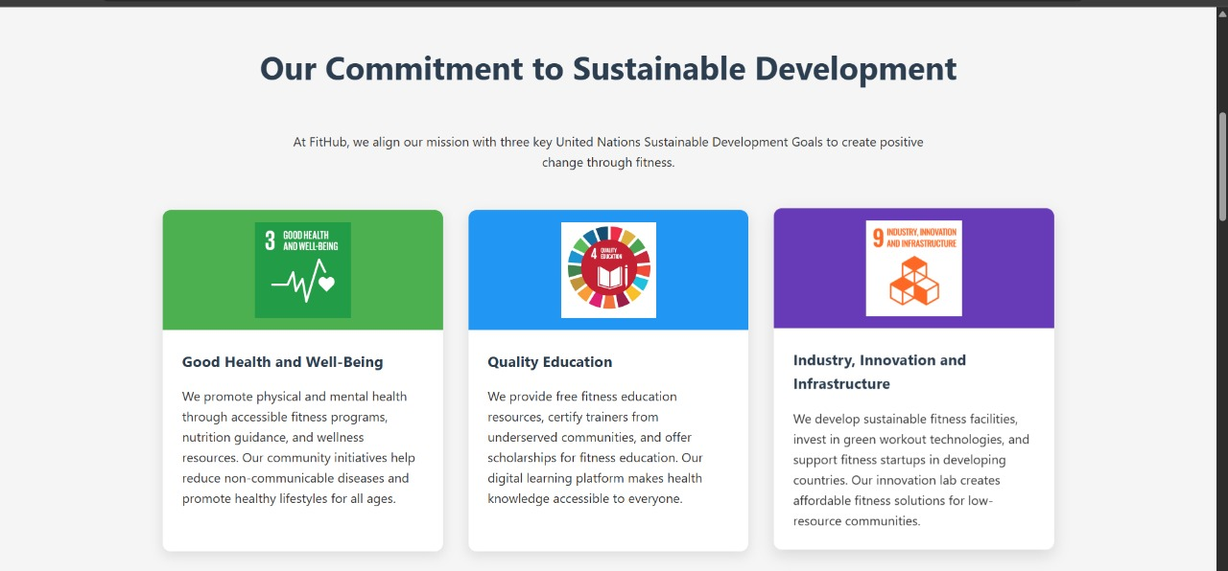
SUSTAINABLE GOALS COVERED
Image showing Sustainable Goals Covered Under this project
Date – 21 April , 2025 Fit Hub : Your Path To Health , Wellness & Education Through Innovation 41

Slide 41
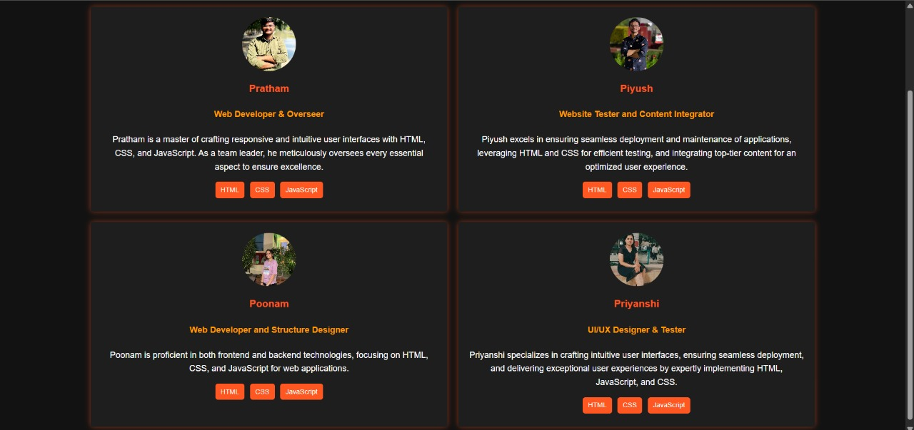
DEVELOPERS
Image showing Developers Of Fit Hub Website
Date – 21 April , 2025 Fit Hub : Your Path To Health , Wellness & Education Through Innovation 42

Slide 42
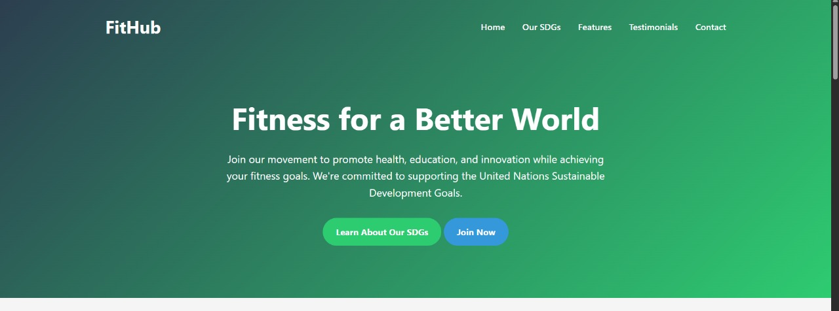
JOIN NOW PAGE
Image showing Join Now page of Fit Hub
Date – 21 April , 2025 Fit Hub : Your Path To Health , Wellness & Education Through Innovation 43

